Slide 1
AQUA
AQUA
SIGHT
SIGHT
Portable AI drowning detection for community pools
Westwood High School | Evan Gipson, Jordyn Choe
1

Slide 2
AQUA SIGHT
What’s the need?
01
The Problem
About 800 people drown every day worldwide. It's the #1 cause of death for kids ages 1 to 4.
02
The Market Gap
About 1 in 3 U.S. public pools has been hit by the lifeguard shortage, and detection systems cost $50,000+.
03
Our Solution
Smart wristbands plus AI underwater cameras that warn lifeguards before a swimmer goes under.
04
How It Works
Three layers of detection: surface behavior, wristband sensors, and camera confirmation.
05
Why We Win
The only portable system combining wristbands and cameras. No construction. No video recorded.
06
The Ask
$150,000 for 15% equity ($1M post-money valuation).
Market research: [ADD SURVEY RESULT, e.g., 'X of Y pool staff surveyed said they would want this at their pool']
2

Slide 3
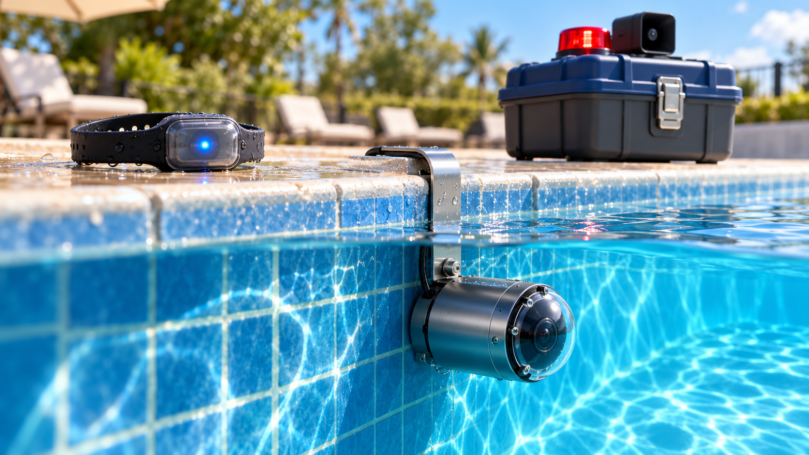
AQUA SIGHT
Aqua Sight
Three devices. Three layers of detection. One alarm that comes in time.
How Aqua Sight detects drowning
Layer 1: Surface Behavior AI
Cameras recognize Instinctive Drowning Response: body vertical, head back, arms pressing down. Warns lifeguards BEFORE submersion.
Layer 2: Smart Wristband Sensors
Tracks time underwater, sinking speed, and arm stoppage. Beginner & toddler bands trigger faster.
Layer 3: Multi-Camera Confirmation
Cross-checks swimmer position & confirms head depth. Catches swimmers on bottom, band or no band.
[ RENDER D: HERO SHOT ]
1. Smart Wristband
2. Underwater AI Camera
3. Deck Hub
(Clamps onto any pool in 15 mins. No construction.)
SAFE: Normal swimming
WATCH: Smartwatch buzzes 'Check lane 3'
ALARM: Siren, strobe, exact spot on dashboard
3

Slide 4
AQUA SIGHT
Product Cost
BUY
$9,999
one time + $99/mo
SUBSCRIBE
$399
per month, $0 upfront
RENT
$299
per weekend (meets/camps)
Unit Cost to Make (One Full Kit):
• 4 underwater AI camera pods ($395 ea): $1,580
• 1 deck hub with siren & alarm: $200
• 100 smart wristbands ($22 ea): $2,200
• 2 band charging racks: $180
• Carry case and packaging: $120
TOTAL COST PER KIT: $4,280
(Plus $350 setup & staff training per pool)
Subscription Profitability:
• $399 monthly price minus $40 cloud/warranty costs
• Net: $359 per month per kit
• Kit + setup ($4,630) paid back in ~13 months, then pure margin
Purchase Margin: $4679 per system (47%, after setup and fees)
Rental Margin: $224 profit per weekend
Profit from 2025-2026: $100,000
4

Slide 5
AQUA SIGHT
Our Pitch Video
Aqua Sight Video
5

Slide 6
AQUA SIGHT
Investor Request
Where your money goes (Year 1) — Total: $150,000
• Hardware fleet (18 kits): $79,500 (53%)
• Team: $21,000 (14%)
• Engineering and testing: $18,000 (12%)
• Marketing and trade shows: $10,500 (7%)
• Insurance, legal, patents, software: $10,500 (7%)
• Loan payments: $10,500 (7%)
$150,000
for 15% equity
$1,000,000 post-money valuation
Milestones we’ve completed:
• 5 pilot pools at camps and YMCAs, free through summer (April-August 2026), then converting to paid
• Round Rock, Leander, and Austin ISD pools utilizing our product.
6

Slide 7
AQUA SIGHT
How Much We've Made So Far
Revenue to date
Summer 2026
5 free pilot pools at camps and YMCAs
$5,185
Subscriptions: $2,793 (7 pools × $399, September)
Event rentals: $2,392 (8 summer weekends × $299)
Monthly recurring revenue today: $2,793
On pace for $33,516 a year, before any new customers.
September 2026
4 of 5 pilots converted to paid subscriptions
Fall 2026
Round Rock, Leander, and Austin ISD pools signed on
7

Slide 8
AQUA SIGHT
How We Compare
Competitor | Approach | Price | Installation
Lynxight (one German pool) | AI cameras only | €50,000 | Permanent install
Ellis (Fort Wayne school district) | Cameras only | $253,837 | Permanent install
WAVE | Wearables only, can't see the swimmer | Up to $399/month | Wireless
Coral Manta | One camera, built for home pools | About $2,500 | Pool edge
Aqua Sight | Cameras + 100 wristbands | $399/month | Clamps on in 15 minutes
The only portable system that combines wristbands and AI cameras.
Sources: KölnBäder; Fort Wayne Journal Gazette; WAVE published pricing; GovTech.
8

Slide 9
Thank
Thank
You
You
Portable AI drowning detection for community pools
Westwood High School | Evan Gipson, Jordyn Choe
9

